Slide 1
FWD Project
TOGAF 9 - Core Diagrams Application and User Location Diagram Phase C – Information Systems Architectures

Slide 2
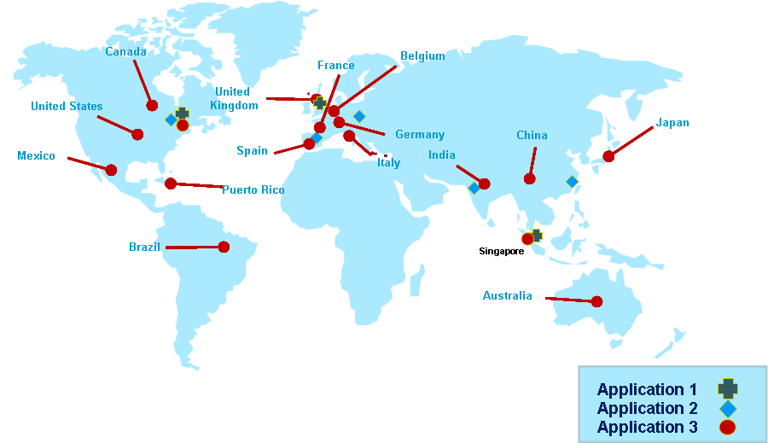
Application and User Location Diagram

Slide 3
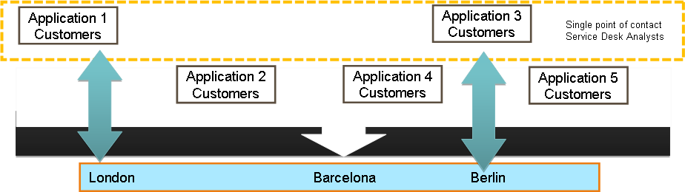
Application and User Location Diagram

Slide 4
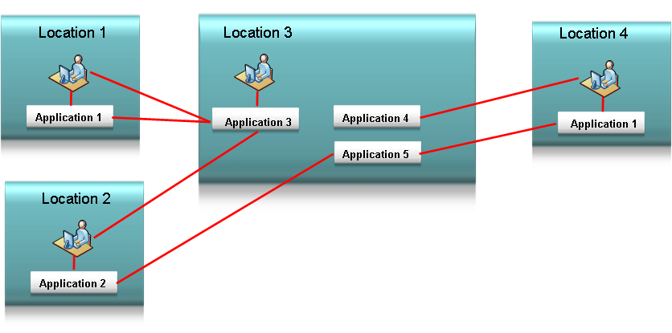
Application and User Location Diagram

